Slide 1



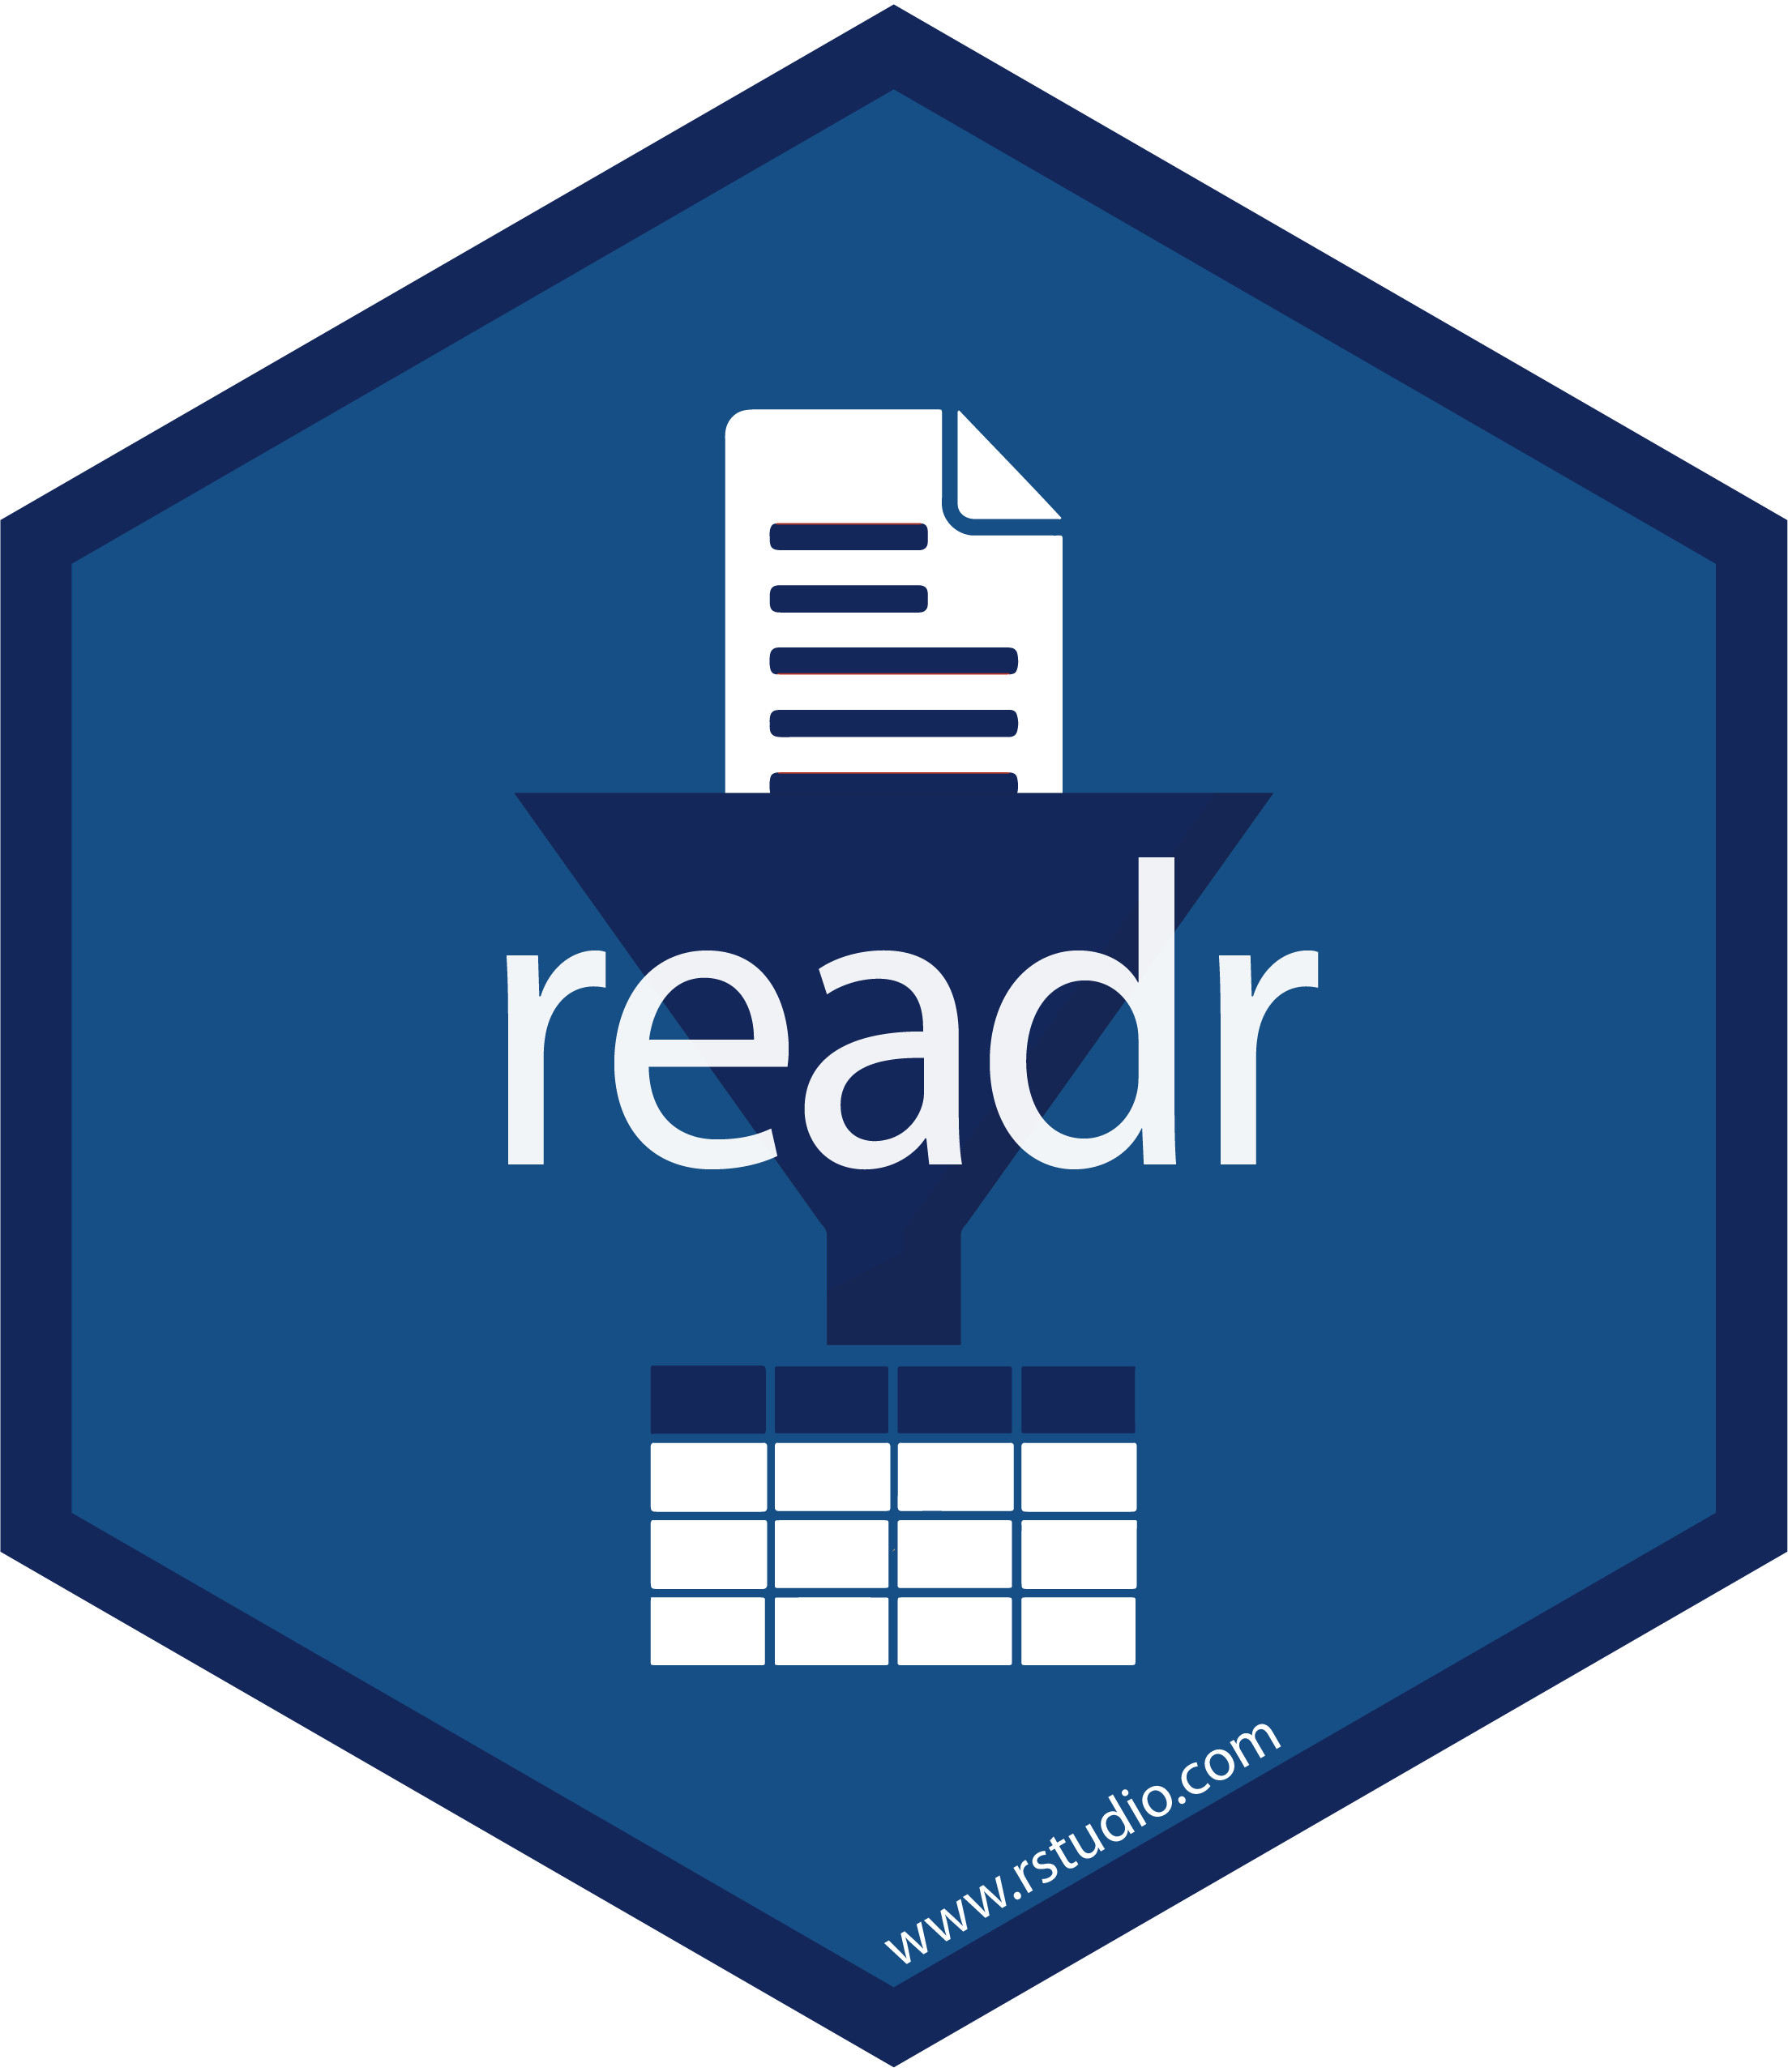
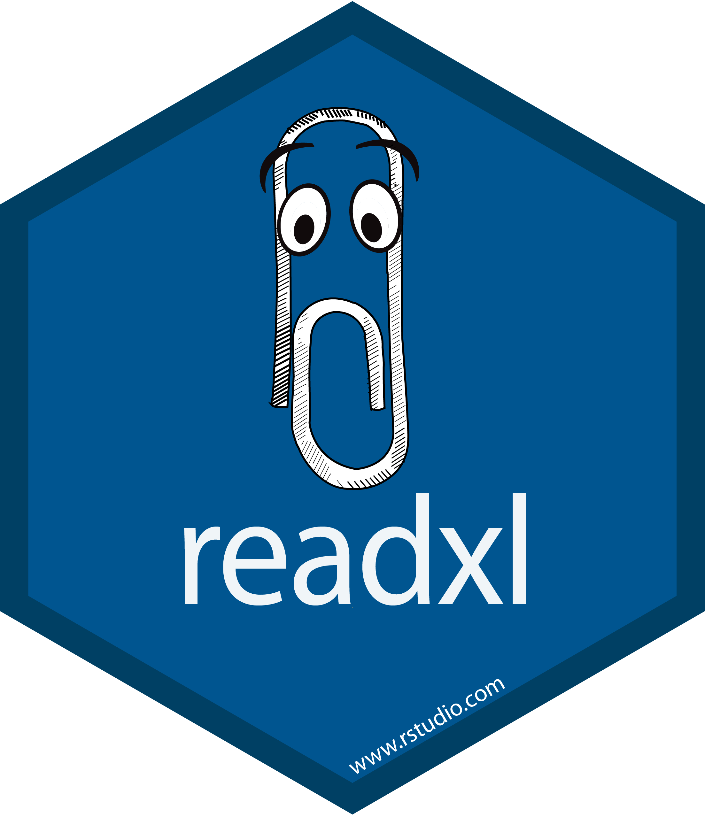
Import Data Into
Part 1 of Analytic with Tidyverse series

Slide 2
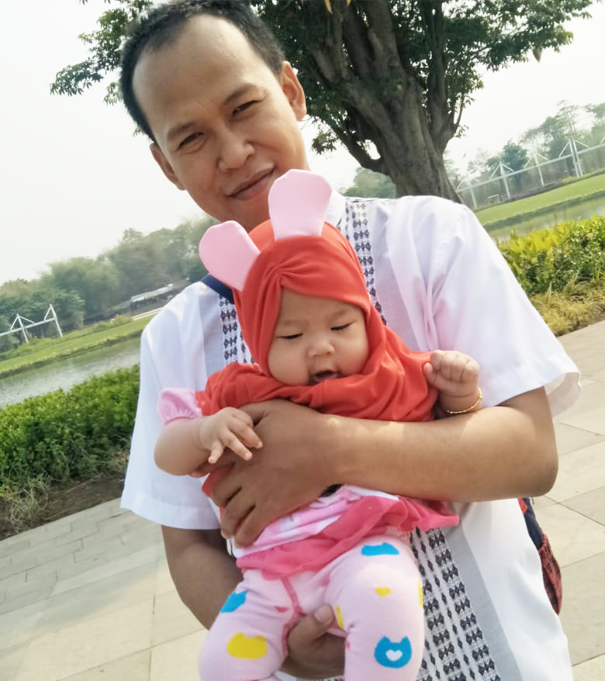


{Aep Hidayatuloh}
Nama Panggilan | : Aep
Daerah Asal | : Cikarang, Bekasi
Tempat Tinggal | : Cikarang, Bekasi
Angkatan | : STK 46
Pekerjaan | : - Senior Data Analyst at Starcore Analytics
 | - Customer Value Management at PT Asuransi Jiwa Sequislife
 | - Statistician & App Developer at PT Ganesha Cipta Informatika
Github | : https://github.com/aephidayatuloh
Email | : aephidayatuloh.mail@gmail.com
Rpubs | : https://rpubs.com/aephidayatuloh
telegram community
R Indonesia
https://t.me/GNURIndonesia

Slide 3
{Prerequisite}
Internet Connection
Basic R Knowledge
Software Installed:
R program [https://cran.r-project.org/]
RStudio [https://www.rstudio.com/products/rstudio/download/]
Data & Scripts:
Download from https://github.com/aephidayatuloh/01-import
R Packages:
Use install.packages("tidyverse") to install tidyverse packages.
tidyverse | : | install.packages("tidyverse")
readxl | : | install.packages("readxl")
writexl | : | install.packages("writexl")
dbplyr | : | install.packages("dbplyr")
RSQLite | : | install.packages("RSQLite")
RMySQL | : | install.packages("RMySQL")
jsonlite | : | install.packages("jsonlite")

Slide 4
What Will Be Discussed?

Slide 5
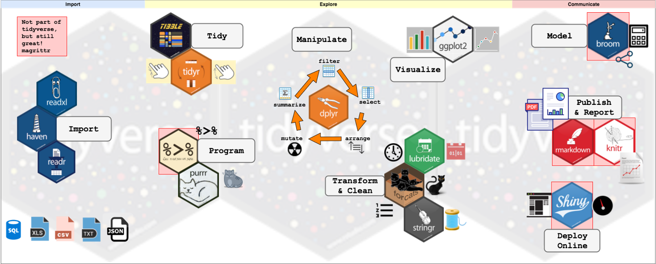
Tidyverse Series Flow

Slide 6

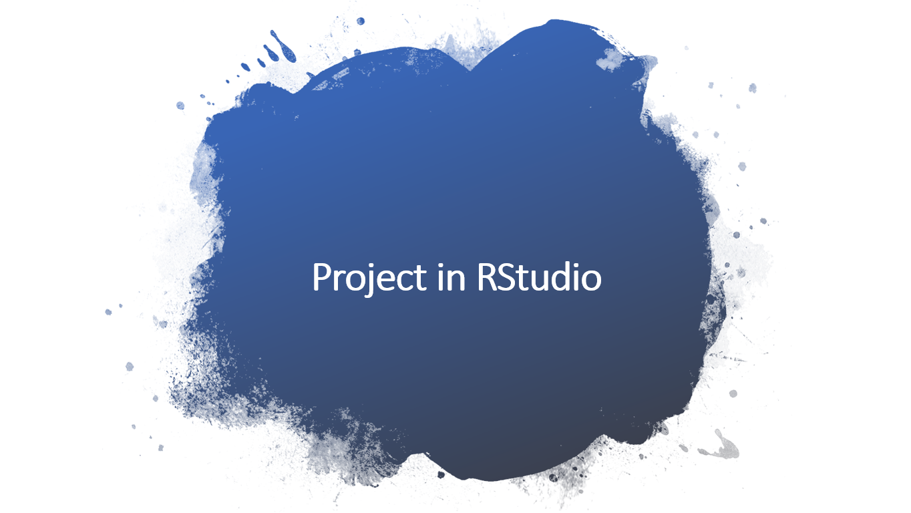
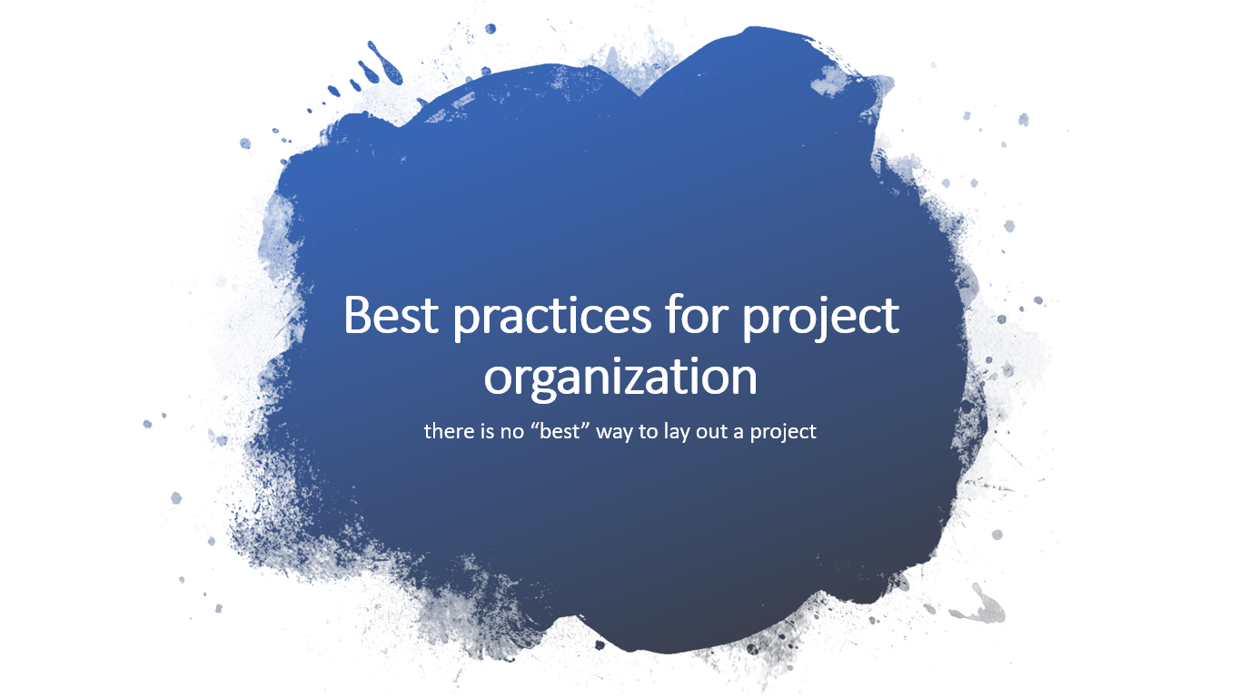
Outline

Slide 7
Introduction

Slide 8
Welcome to RStudio
is one of most used Integrated Development Environment (IDE) for R that makes it easy to build R script in more interactive mode.
i.e. auto-complete code, organized panel and many more useful functional.
RStudio is available in two formats:
RStudio Desktop -> program is run locally as a regular desktop application;
RStudio Server -> allows accessing RStudio using a web browser while it is running on a remote Linux server.
RStudio Desktop and RStudio Server are both available in free and fee-based (commercial) editions.
Download latest version of RStudio [https://www.rstudio.com/products/rstudio/download/]

Slide 9
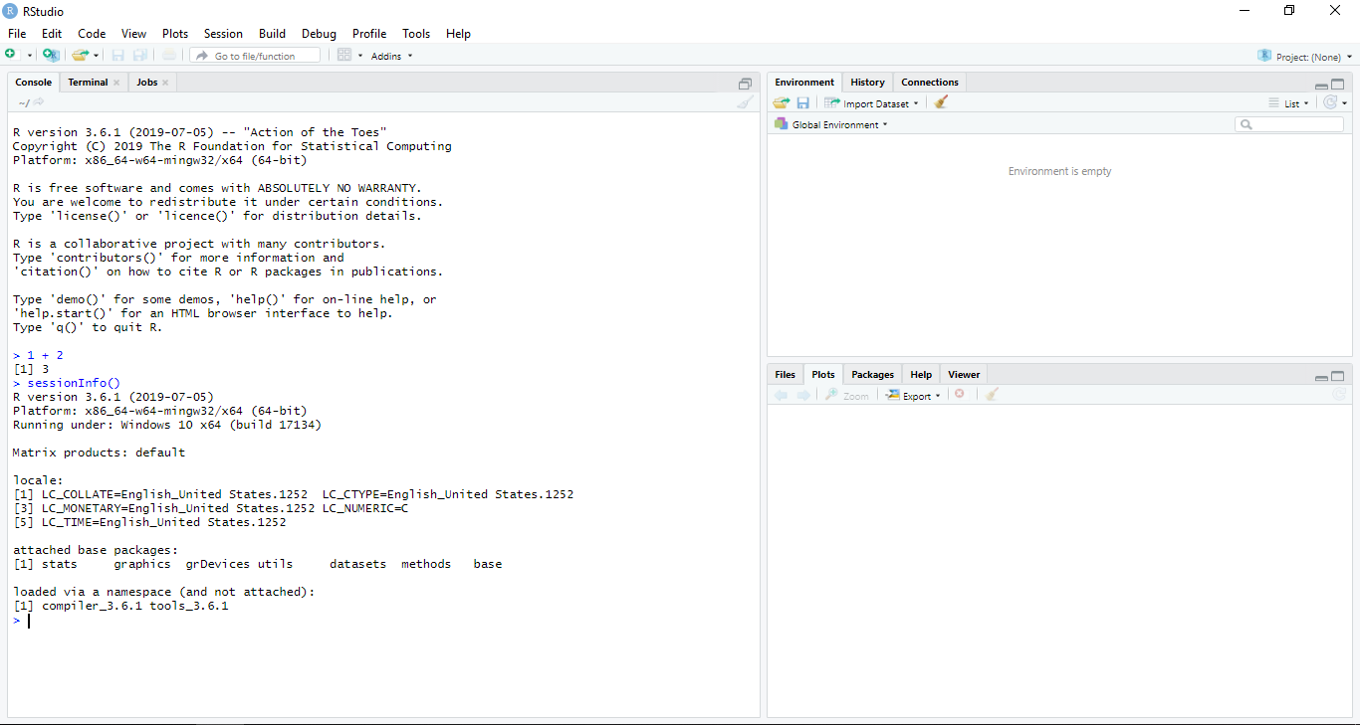
RStudio
Console/Terminal/Jobs
Environment/History/
Connections
Files/Plots/Packages/
Help/Viewer

Slide 10
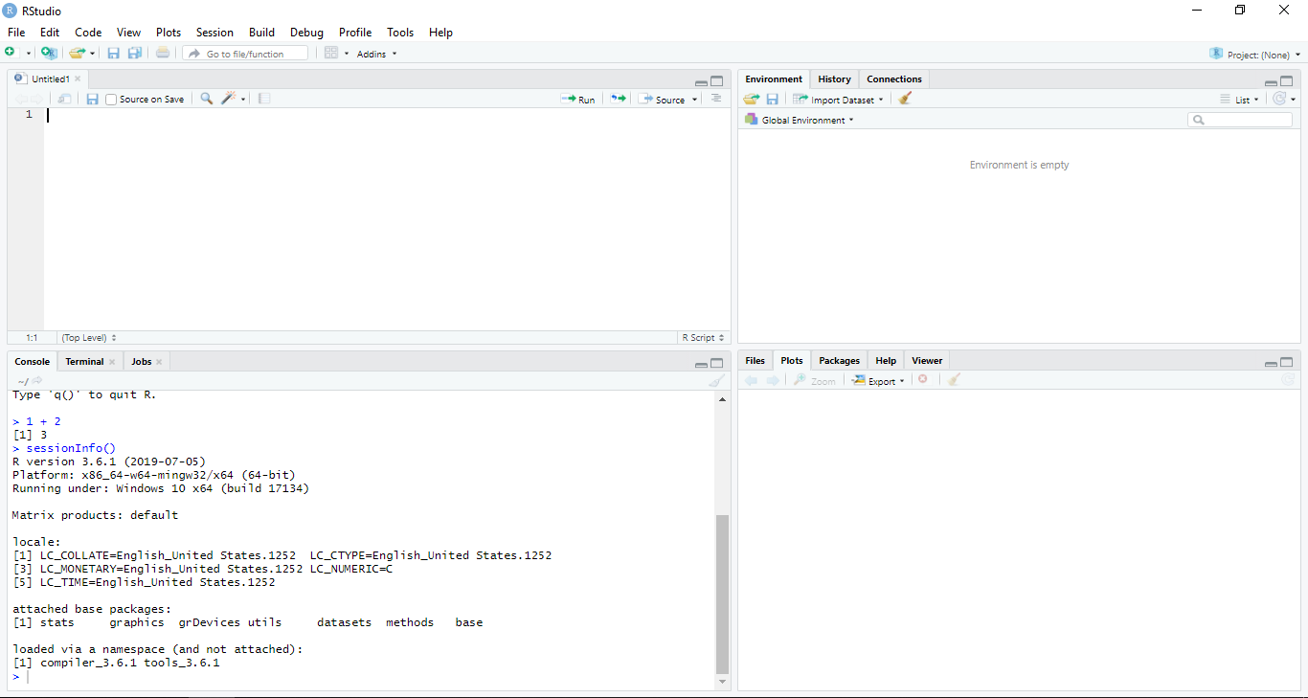
RStudio
Script Editor
File -> New File -> R Script
(Ctrl + Shift + N)
Environment/History/
Connections
Console/Terminal/Jobs
Files/Plots/Packages/
Help/Viewer

Slide 11
Outline

Slide 12
External Data File
TXT, CSV, Excel & Online Data File

Slide 13
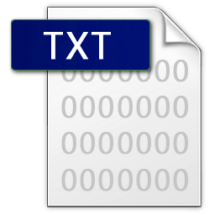
Import TXT File
library(readr)
# or
library(tidyverse)
# Read File
iris_txt <- read_delim("../data/iris.txt", delim = " ") # space
str(iris_txt)
head(iris_txt)
# Write File
write_delim(iris, "../output/iris_out.txt", delim = "|")

Slide 14
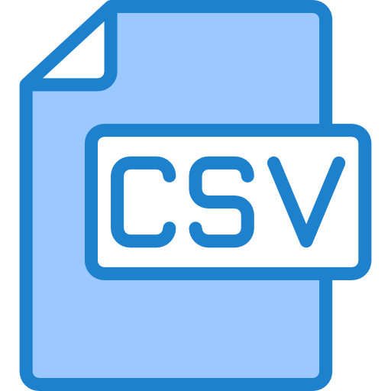
Import CSV File
library(readr)
# or
library(tidyverse)
# Read File
iris_csv <- read_csv("../data/iris.csv")
str(iris_csv)
head(iris_csv)
# Write File
write_csv(iris, "../output/iris_out.csv")

Slide 15
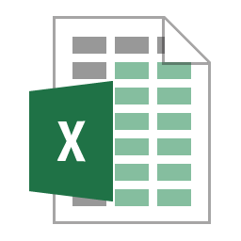
Import Excel File
# Read File
library(readxl)
iris_xl <- read_excel("../data/iris.xlsx")
str(iris_xl)
head(iris_xl)
# Write File
library(writexl)
write_xlsx(iris, "../output/iris_out.xlsx")

Slide 16
Online Data File
Repository data : https://github.com/aephidayatuloh/datasets
Data location : https://raw.githubusercontent.com/aephidayatuloh/datasets/master/iris.csv
dt_url <- "https://raw.githubusercontent.com/aephidayatuloh/datasets/master/iris.csv"
gc <- read_csv(dt_url)
str(gc)
head(gc)

Slide 17
Challenge 1
Challenge: Read Online Data
Import a diamonds.csv online data file to RStudio from https://github.com/aephidayatuloh/01-import repository.

Slide 18
Outline

Slide 19
Databases
SQLite and MySQL Database

Slide 20
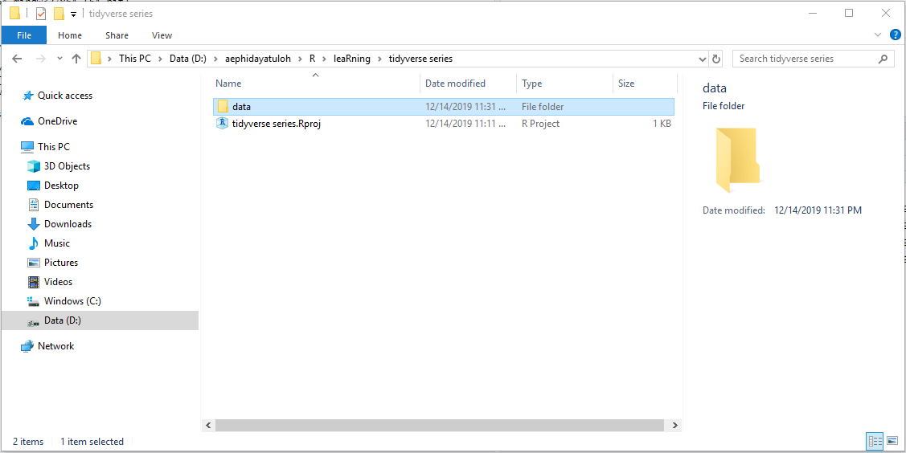
SQLite
SQLite is database with file-based → create data folder
Do not modify the original data!

Slide 21
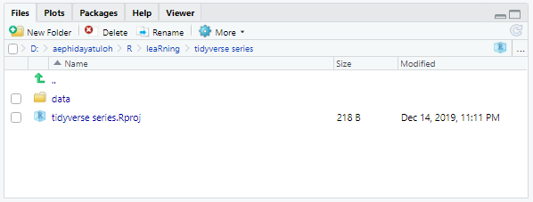
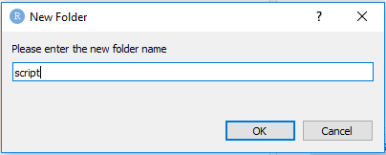
R Script
Create script or src folder for R or other script and anything related to it.
Name file (not only script) with history-like, for changes
Save-as script.R as script_20191201.R
Edit the script.R file as the last updated script

Slide 22
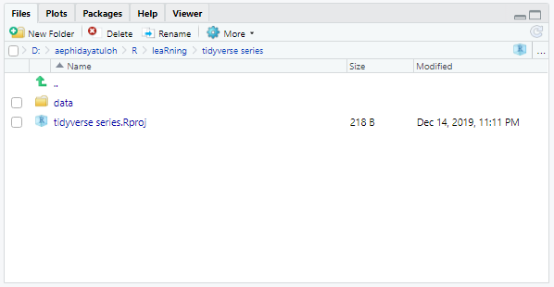
Function Definition Script
Separate function definition script and application script where it used.

Slide 23
Output
Create output folder for all output
Do not modify output file directly → copy then modify!
Documents
Create docs folder for all document associated with the project.

Slide 24
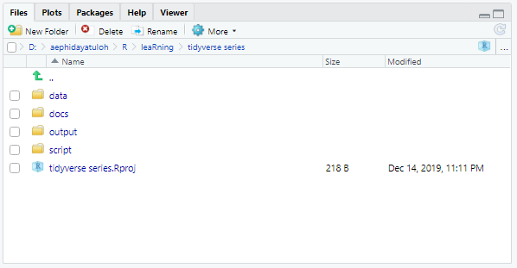
Summary
Key Point
Use RStudio to create and manage projects with consistent layout. Create folder for data, script, output, documents, etc. Treat raw data as read-only. Treat generated output as disposable. Separate function definition and application.

Slide 25
??? {Q & A}

Slide 26
ThankQ

